Slide 1
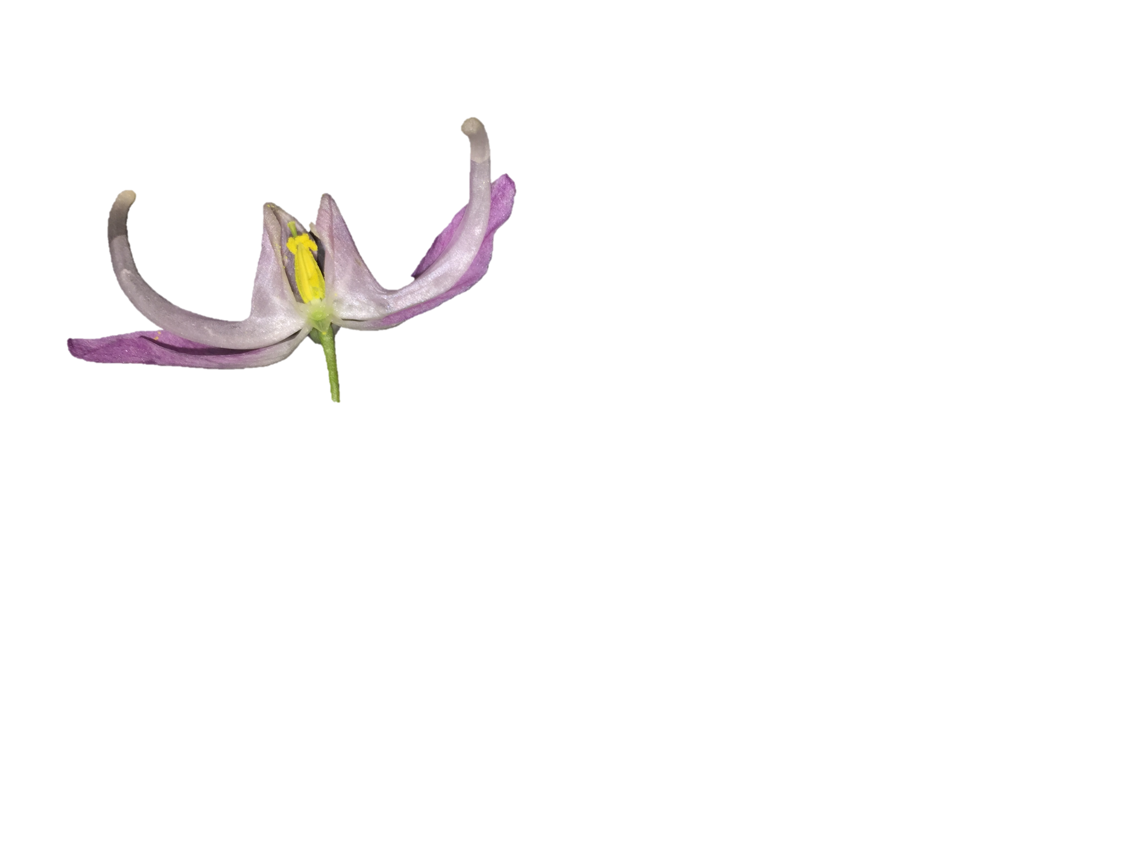
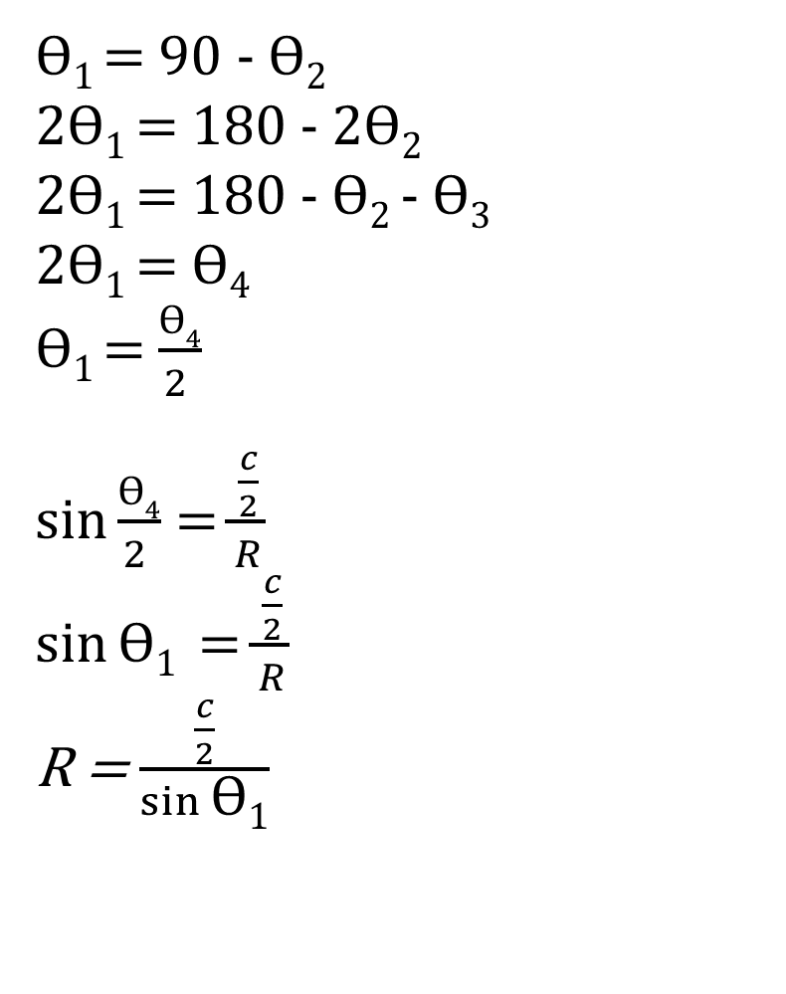
ϴ₁
ϴ₂
ϴ₁ = 90 - ϴ₂
2ϴ₁ = 180 - 2ϴ₂
2ϴ₁ = 180 - ϴ₂ - ϴ₃
2ϴ₁ = ϴ₄
ϴ₁ = $\frac{ϴ4}{2 }$
$\sin{\frac{ϴ4}{2 }}$ = $\frac{\frac{c}{2}}{R}$
$\sin{\text{ϴ}\text{1}}$ = $\frac{\frac{c}{2}}{R}$
R = $\frac{\frac{c}{2}}{\sin{\text{ϴ}\text{1}}}$
R
C
ϴ₄
ϴ₃
Notes:
Figure S1

Slide 2
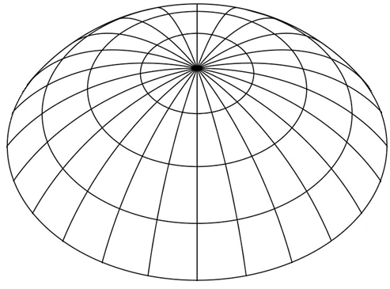
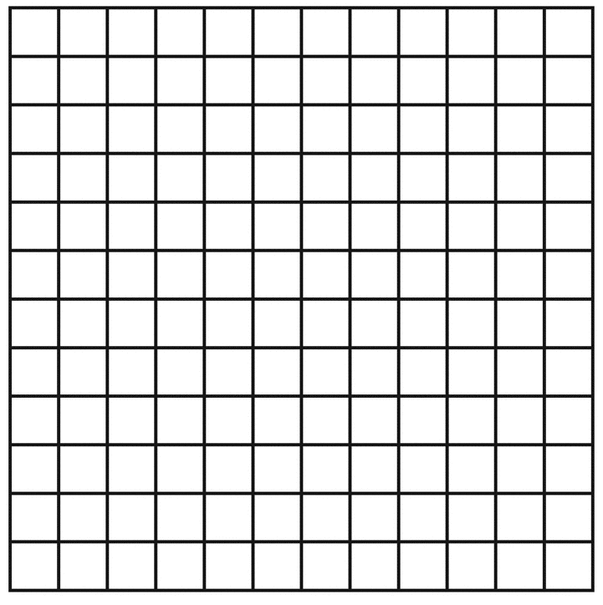
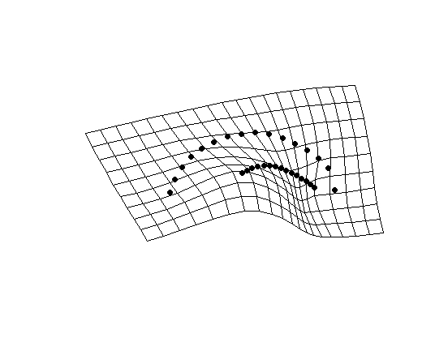
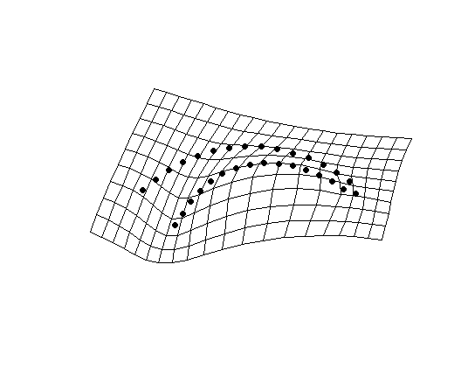
1.
y
2.
x
PC2
3.
PC1
Notes:
Landmarks and semi-landmarks are assigned to a specimen with each point having an (xy) coordinate.
For each specimen, a configuration of landmarks exists as a single point in a non-Euclidian shape space (abstracted here as a simple sphere). Red points represent landmark configurations from other specimens.
Shape data is projected onto a Euclidian plane – a tangent space approximation. This allows statistical analyses of shape variation (e.g. principal components analysis).

Slide 3
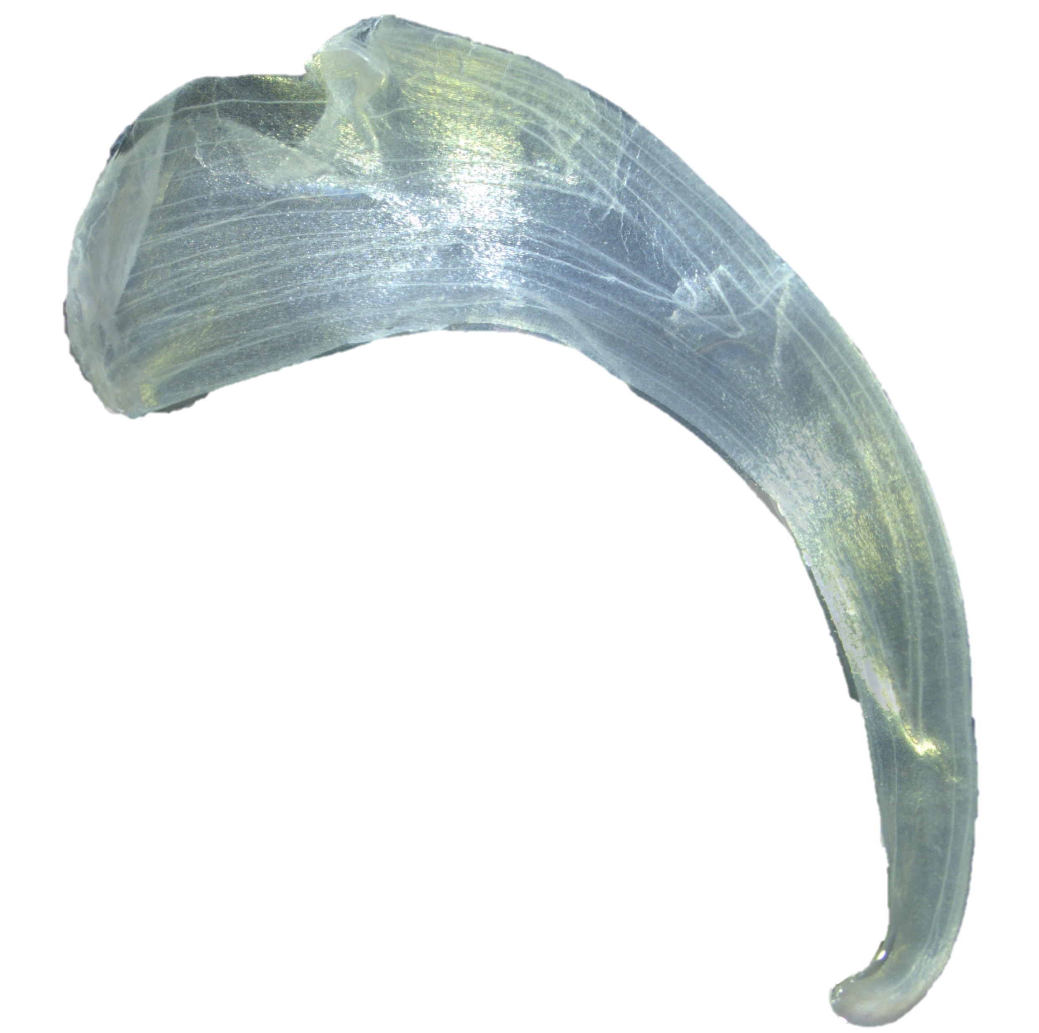
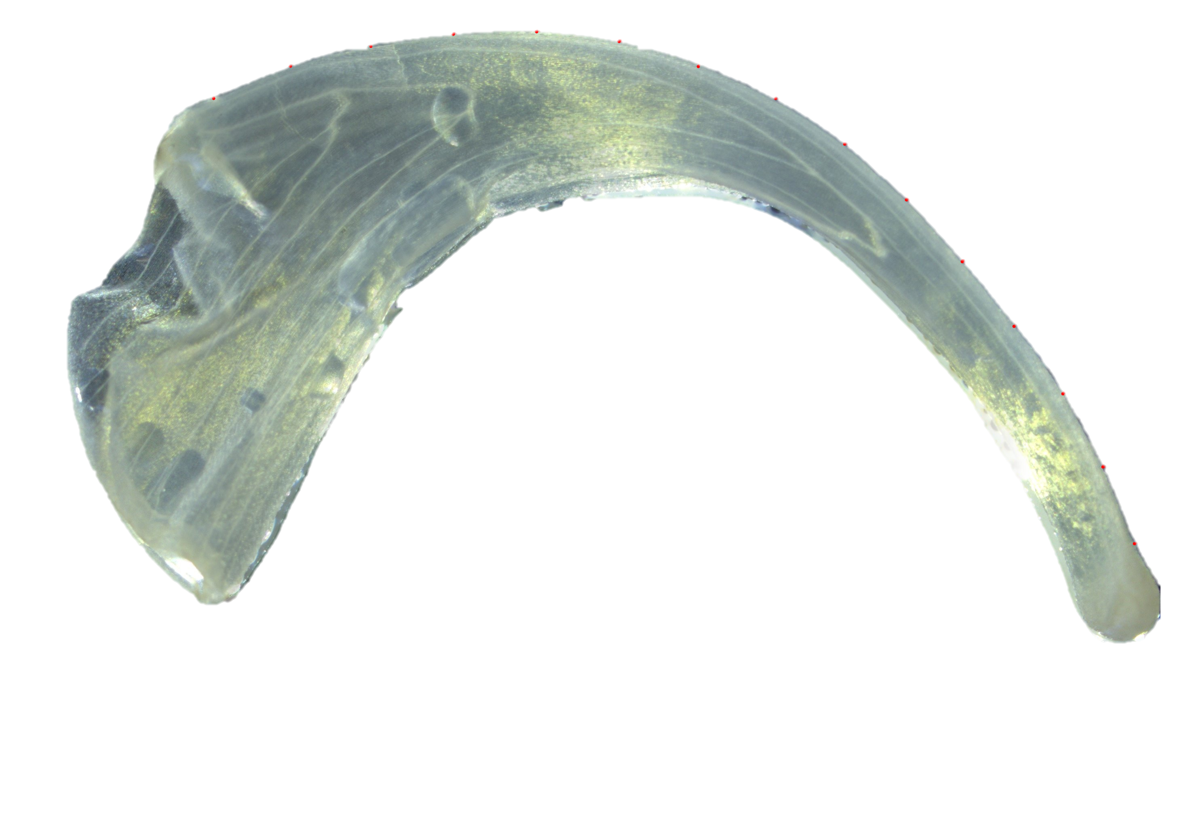
1.
2.
2 mm
Notes:
Figure S2: Homologous landmarks placed for Epimedium violaceum (1), Epimedium koreanum (2), and Epimedium grandiflorum (3). Thirteen equidistant semi-landmarks were placed between the two landmarks making 15 landmarks total.

Slide 4
30
20
sepal size (mm)
10
Species
E. koreanum
E. violaceum
0
C G T A
developmental stage

Slide 5
25
20
15
days elapsed
10
Species
E. koreanum
E. violaceum
5
0
C G T A
developmental stage

Slide 6
150
Species
E. koreanum
E. violaceum
125
total curvature (degrees)
100
75
50
C G T A
developmental stage

Slide 7
total curvature (1)
angle of deflection (2)
arc:chord ratio (3)
mandibular index (4)
inverse radius (5)
0.015
0.010
0.005
0.000
(1)
80
60
40
20
Species
E. koreanum
E. violaceum
(2)
1.5
1.4
1.3
1.2
1.1
(3)
8
6
4
2
(4)
0.3
0.2
0.1
0.0
(5)

Slide 8
root of squared residuals
root mean square error of circle fit
Notes:
Figure XX. The x-axis is the root mean square from pracma::circlefit(). Values closer to zero are closer to circles. The y-axis is the residuals from the correlation between total curvature and the inverse radius. The greater the residuals, the more that the two metrics are discordant.

Slide 9
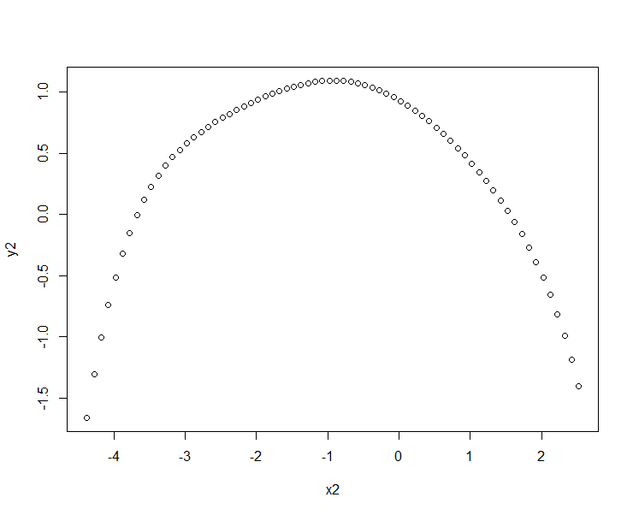
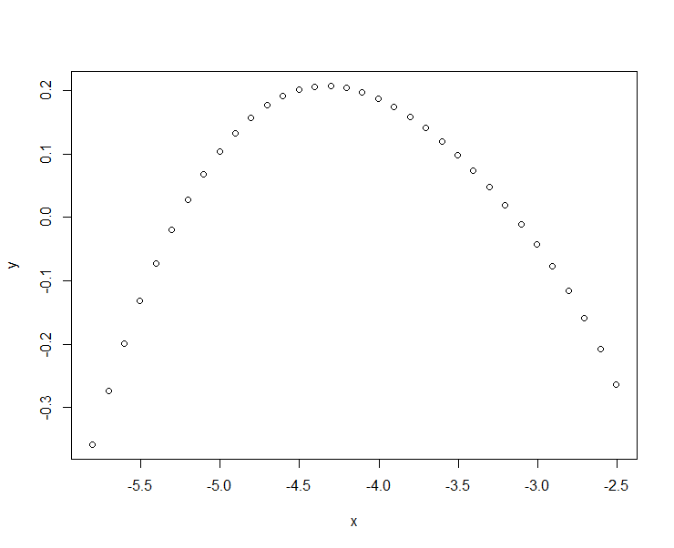
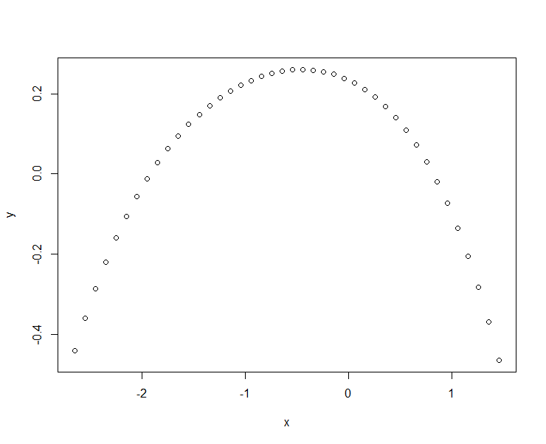
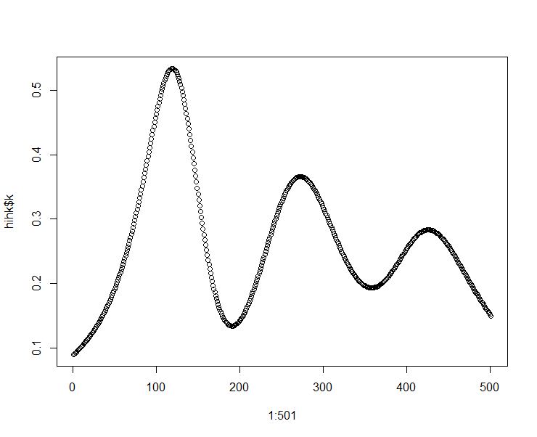
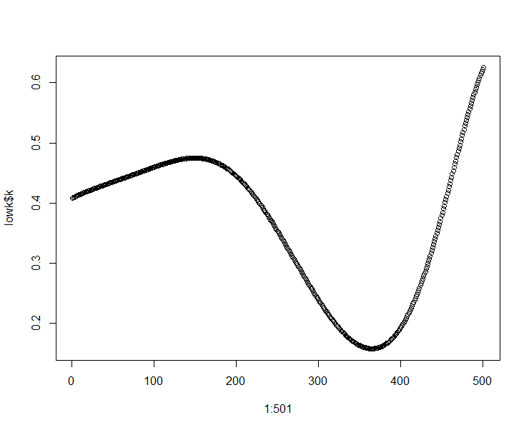
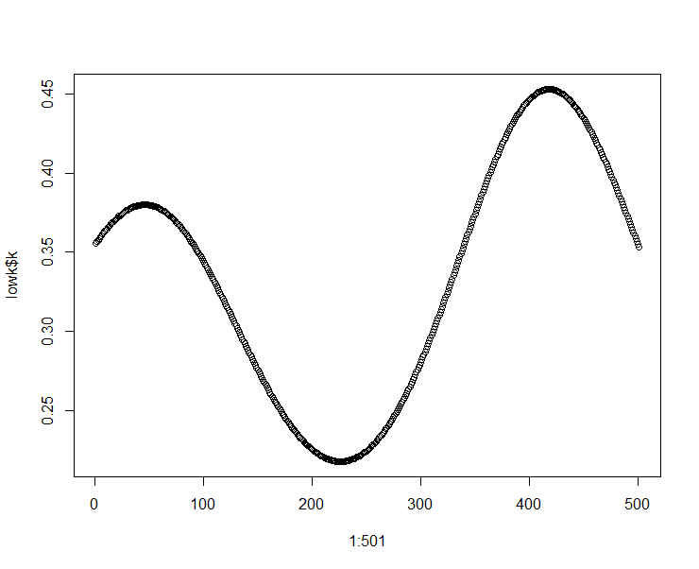
K_1_8_1
K_2_3_3
K_2_3_2
Notes:
Impacts of local curvature. The top row illustrates polynomial curves fitted to three nectar spurs. The bottom row illustrates point-wise curvature for each polynomial. By visual inspection, K_1_8_1 does not appear to be less curved than the proceeding specimens. However, an analysis of curvature reveals local ‘flat spots’ that impact total curvature.

Slide 10
s₂
ϴ₂
ϴ₁
s₁
v₂
v₁
C₁
C₂
C₁ = C₂
ϴ₁ < ϴ₂
S₁ < S₂
v₁ < v₂
Notes:
Impacts of circularity. For two curves (bounded by the green landmarks) with the same chord length, the angle of deflection $\theta$, arc:chord ratio ( $s / C$ ), and mandibular index ( $C / v$ ) can vary with curvature. For the steep curve fitted by an ellipse (right), the arc:chord ratio and angle of deflection will be greater than for the circle (left). The mandibular index will be less. Thus, regardless of circularity, the arc:chord ration and angle of deflection will be positively correlated, and both will be negatively correlated with the mandibular index (see: Figure S7).

Slide 11
ϴ₁
ϴ₂
s₂
s₁
v₁
C₂
v₂
C₁
C₁ = C₂
ϴ₁ = ϴ₂
S₁ < S₂
v₁ < v₂
Notes:
Impacts of circularity. For two curves (bounded by the green landmarks) with the same chord length, the angle of deflection $\theta$, arc:chord ratio ( $s / C$ ), and mandibular index ( $C / v$ ) can vary with curvature. For the steep curve fitted by an ellipse (right), the arc:chord ratio and angle of deflection will be greater than for the circle (left). The mandibular index will be less. Thus, regardless of circularity, the arc:chord ration and angle of deflection will be positively correlated, and both will be negatively correlated with the mandibular index (see: Figure S7).

Slide 12
ϴ₁
s₁
C₁
v₁
Notes:
Impacts of circularity. For two curves (bounded by the green landmarks) with the same chord length, the angle of deflection $\theta$, arc:chord ratio ( $s / C$ ), and mandibular index ( $C / v$ ) can vary with curvature. For the steep curve fitted by an ellipse (right), the arc:chord ratio and angle of deflection will be greater than for the circle (left). The mandibular index will be less. Thus, regardless of circularity, the arc:chord ration and angle of deflection will be positively correlated, and both will be negatively correlated with the mandibular index (see: Figure S7).

